Slide 1
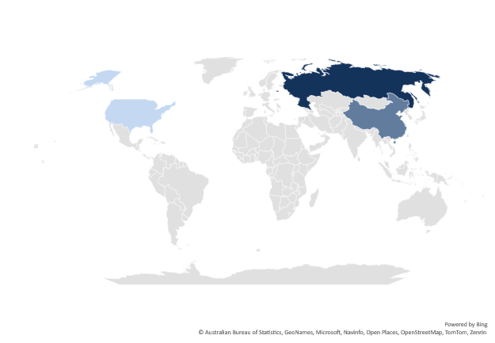
USA | 5
Russia | 50
China | 30

Slide 2
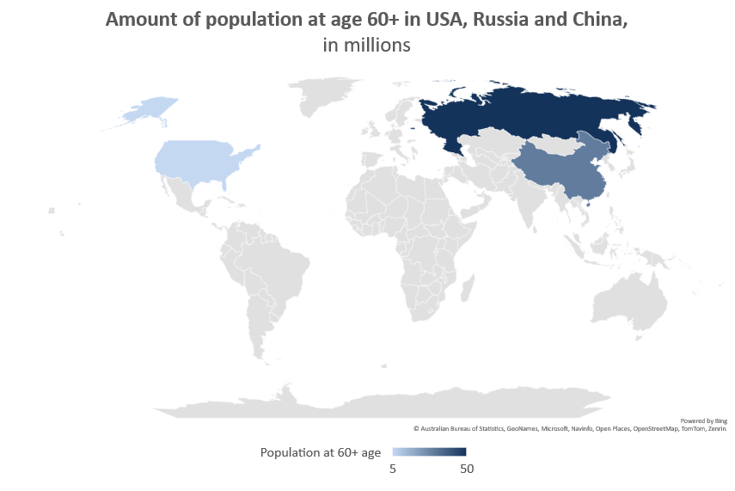
Exercise: Native PowerPoint Map

Slide 3
1. Add a native PowerPoint map
2. Add just 1 country to see the result
3. Add multiple countries, change the data
4. Add a title or rename the series. Try to move the title
5. Think about the drawbacks of this chart

